Slide 1



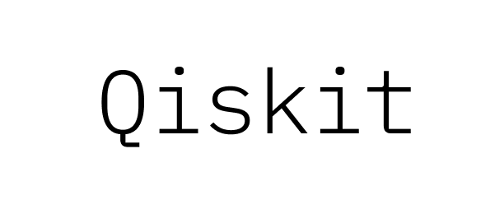

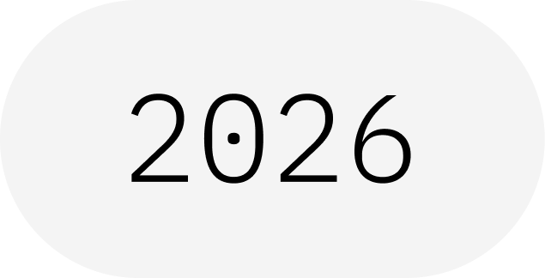
Measurement
Turning Qubits Into Bits
IBM Quantum School
Saad Ejaz • Guest Speaker
Qiskit Fall Fest 2026 at University of Engineering & Technology Lahore,Narowal Campus

Slide 2
01
SPEAKER INTRODUCTION
Saad Ejaz
Guest Speaker
Computer Engineering student and IBM Quantum School tutor, introducing quantum measurement and how a qubit state becomes a classical result.
IBM Quantum School
Qiskit Fall Fest 2026 at University of Engineering & Technology Lahore,Narowal Campus

Slide 3
02
TABLE OF CONTENTS
01
What Is Measurement?
02
How Measurement Works
03
Probabilities: Born Rule
04
Measurement Bases
05
Basic Qiskit Implementation
06
Takeaways & Resources
Qiskit Fall Fest 2026 at University of Engineering & Technology Lahore,Narowal Campus

Slide 4
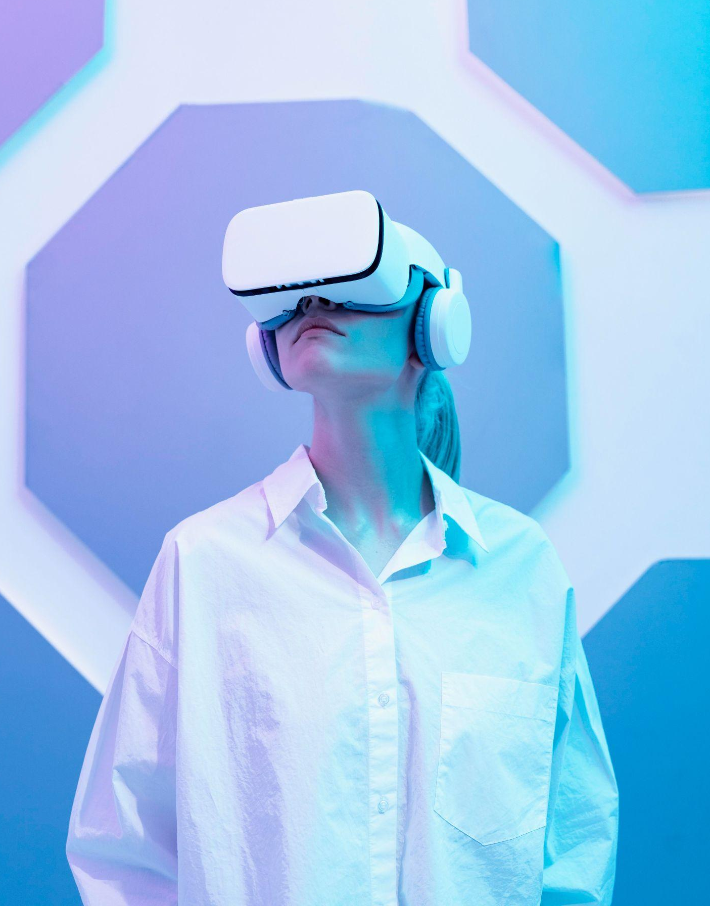
WHAT IS A QISKIT FALL FEST?
03
A beginner-friendly session on quantum measurement: how a qubit state turns into a classical result, and how to measure in Qiskit.
Qiskit Fall Fest 2026 at University of Engineering & Technology Lahore,Narowal Campus

Slide 5
04
INTRODUCTION
01
Qiskit Fall Fest 2026 at University of Engineering & Technology Lahore,Narowal Campus

Slide 6
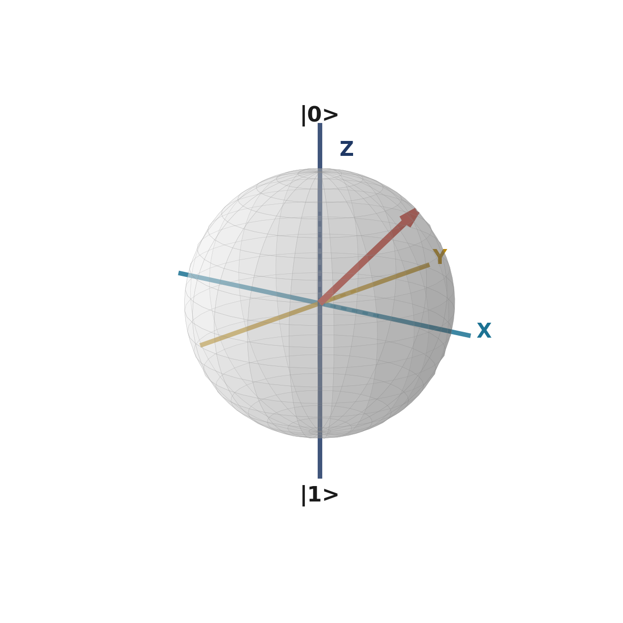
05
WHAT IS MEASUREMENT?
Measurement turns a qubit into a classical bit.
QUBIT STATE
Before measuring, a qubit can be in a superposition. Measuring gives one result: 0 or 1.
The state collapses to the result you got.
MEASUREMENT
CLASSICAL BIT
Qiskit Fall Fest 2026 at University of Engineering & Technology Lahore,Narowal Campus

Slide 7
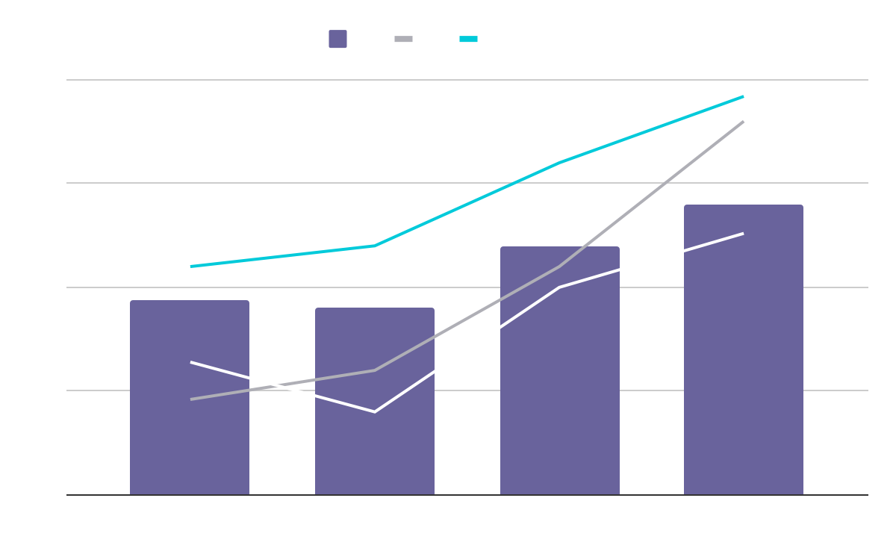
HOW MEASUREMENT WORKS
01
02
03
04
Prepare
Measure
Collapse
Repeat
Put the qubit into a quantum state.
Measure it in the chosen basis.
The state becomes the result you got.
Run many shots to see the probabilities.
One measurement gives one result. Many shots reveal the probabilities.
Qiskit Fall Fest 2026 at University of Engineering & Technology Lahore,Narowal Campus

Slide 8
07
PROBABILITIES & BASES
02
Qiskit Fall Fest 2026 at University of Engineering & Technology Lahore,Narowal Campus

Slide 9
08
THE BORN RULE
The chance of each outcome comes from the amplitudes of the state.
AMPLITUDES
PROBABILITY
SHOTS
One per outcome
Square the size
Many repetitions
A qubit state has an amplitude for 0 and an amplitude for 1.
The chance of an outcome is the squared size of its amplitude.
Repeat the circuit many times to estimate each probability.
Qiskit Fall Fest 2026 at University of Engineering & Technology Lahore,Narowal Campus

Slide 10
09
MEASUREMENT BASES
Z BASIS
OTHER BASES
The default. Results are 0 or 1 along the Z axis.
To measure in X, add an H gate before the measurement.
KEY POINT
Qiskit always measures in the Z basis. Other bases need a gate before the measurement.
Qiskit Fall Fest 2026 at University of Engineering & Technology Lahore,Narowal Campus

Slide 11
10
MEASURING IN QISKIT
Add measurements to the circuit.
MEASURE_ALL()
Results are written to classical bits.
Choose which qubits to measure, or measure them all.
Measures every qubit into a new register named meas.
MEASURE()
Measures chosen qubits into chosen classical bits.
Qiskit Fall Fest 2026 at University of Engineering & Technology Lahore,Narowal Campus

Slide 12
11
WHY MEASUREMENT MATTERS
READING RESULTS
STATE DISTURBANCE
Every quantum algorithm ends by reading out classical bits.
Measuring changes the state, so you cannot reuse it afterward.
SAMPLING
MID-CIRCUIT
Repeated shots give the distribution of outcomes.
Measurements can happen mid-circuit, and results can control later gates.
Qiskit Fall Fest 2026 at University of Engineering & Technology Lahore,Narowal Campus

Slide 13
12
IMPLEMENTATION
03
Qiskit Fall Fest 2026 at University of Engineering & Technology Lahore,Narowal Campus

Slide 14
13
BASIC QISKIT IMPLEMENTATION
EXAMPLE: SUPERPOSITION
# 1. Prepare an equal superposition
qc = QuantumCircuit(1, 1)
qc.h(0)
# 2. Measure the qubit into the classical bit
qc.measure(0, 0)
# 3. Run many shots on a simulator
sim = AerSimulator()
result = sim.run(qc, shots=1024).result()
# 4. Read the counts
print(result.get_counts())
Expect about half 0 and half 1. Imports are omitted for space.
1 Prepare
2 Measure
3 Run
4 Read
Qiskit Fall Fest 2026 at University of Engineering & Technology Lahore,Narowal Campus

Slide 15
14
RESOURCES
IBM QUANTUM LEARNING
Basics of quantum information and measurement.
QISKIT DOCUMENTATION
QuantumCircuit measure() and measure_all() reference.
KEY TAKEAWAY
Measurement turns a quantum state into classical bits.
Qiskit Fall Fest 2026 at University of Engineering & Technology Lahore,Narowal Campus

Slide 16
THANKS!
DO YOU HAVE ANY QUESTIONS?
15
Saad Ejaz • Guest Speaker
IBM Quantum School
Qiskit Fall Fest 2026 at University of Engineering & Technology Lahore,Narowal Campus

